Slide 1
The four clis of the apocalypse
Isaac Levin – application development manager @Microsoft
Isaac.Levin@microsoft.com

Slide 2




https://aka.ms/levin-cli
@isaac2004
@isaac2004
</> https://www.isaaclevin.com

Slide 3
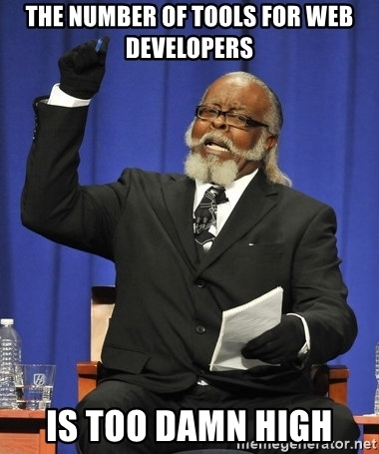


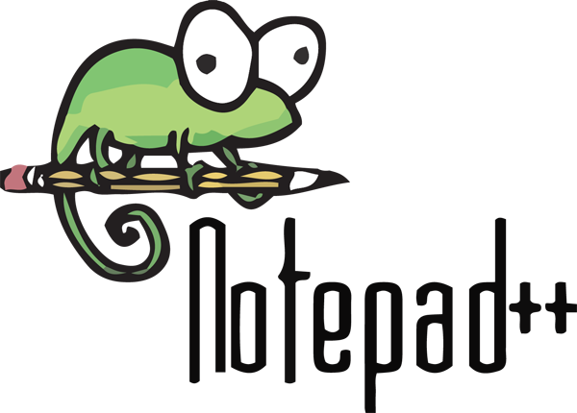
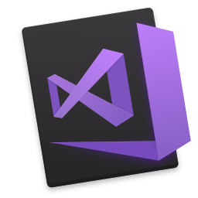

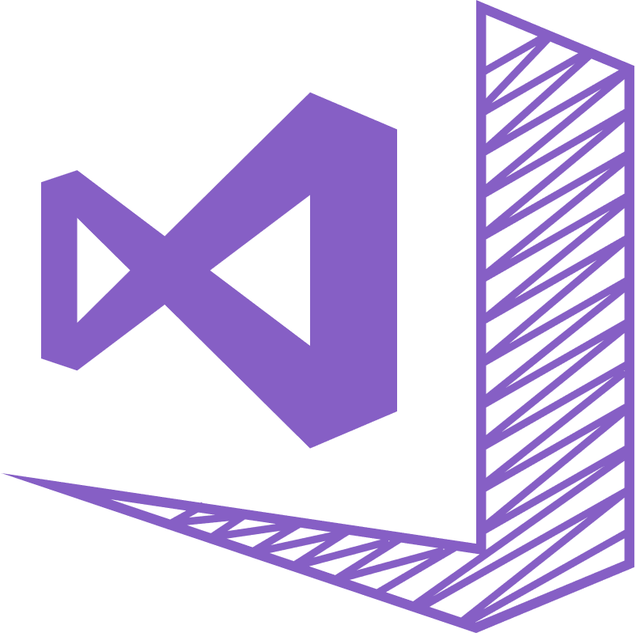

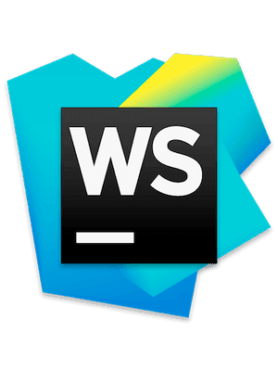

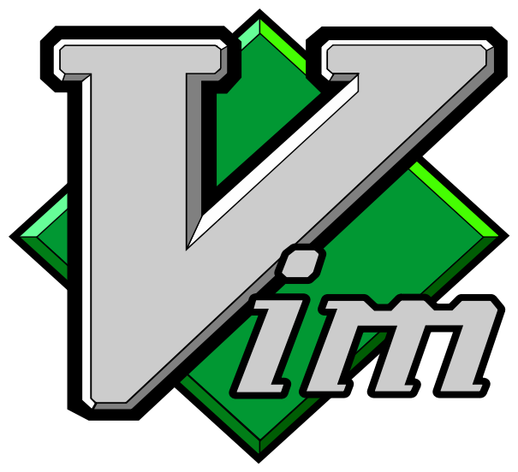


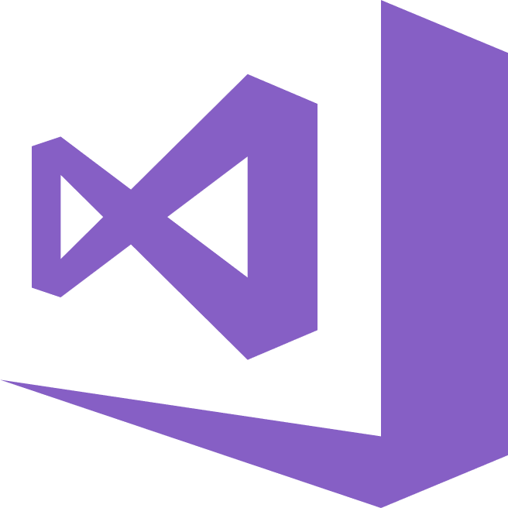
Too many tools!!!

Slide 4
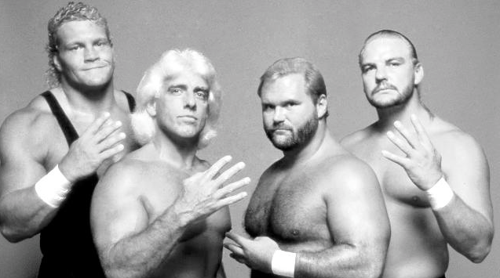
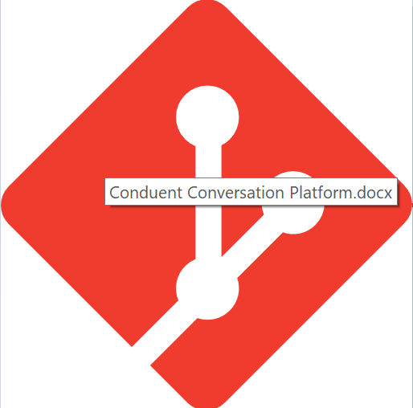

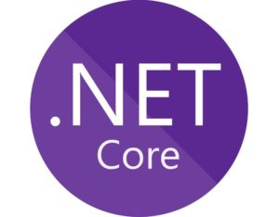

A opinionated solution to the problem

Slide 5

Git BASH
Robust wrapper for managing git repositories
Seamless hook into Unix bash and Windows cmd
Easy way to manage credentials
Works against GitHub, Bitbucket and VSTS repos

Slide 6

Dotnet cli
Project creation 1st class support for command line
Cross-platform (runs everywhere)
Extensible via Global tools (aka create your own)
Integrates with ALM Tools (VSTS)

Slide 7

Angular cli
Installed via NPM
Used to initialize, develop, scaffold and maintain
Removed barrier to entry in creating apps
Runs on top of Webpack, taking away complexity

Slide 8

Azure cli
Administrating and Managing Azure Resources
Can run locally or in Azure Cloud Shell
Integration with Azure Resource Templates (ARM)
Authentication gracefully handled with Azure Login

Slide 9
A VERY LONG DEMO

Slide 10
Resources – https://aka.ms/levin-cli
Git Bash
https://git-scm.com
25 part video series - https://aka.ms/github-youtube-playlist
Dotnet CLI
https://docs.microsoft.com/dotnet/core/tools
DotNet Core CLI Tutorial - https://www.youtube.com/watch?v=j8apQ06fFs0&t=854s
DotNet CLI Global Tools - https://github.com/natemcmaster/dotnet-tools
Angular CLI
https://cli.angular.io/
Angular Talk from John Papa - https://www.youtube.com/watch?v=h7eVZg3j_Lk
Azure CLI
https://docs.microsoft.com/cli/azure
Introducing Azure CLI - https://www.youtube.com/watch?v=laQIC-m9Zn4
Gig (.gitignore generator)
https://www.gitignore.io

Slide 11

Questions and thank you!!!

